Slide 1
Navigating & Thriving in College
Armando Sanchez, LICSW
UW Counseling Center

Slide 2
Today's topics
Stress management
School-life balance
Finding community
Minimizing comparisons to others

Slide 3
Understanding and Managing Stress

Slide 4
Sources of Stress
School/academic
Work, career
Financial
Interpersonal (friends, family, romantic partner, etc.)
Societal, political
And others

Slide 5
Effects of Stress
Anxiety
Difficulty focusing
Low motivation
Procrastination
Irregular sleep patterns
Hopelessness/helplessness
Depression
Tiredness, fatigue
Isolation
Lowered or increased appetite
Rumination, worst-case thinking
And more

Slide 6
Navigating Stress
Check in with yourself
Build self-awareness
Identify sources of stress
Identify needs (mental, emotional, physical, social, etc.)
Check unhelpful/unhealthy beliefs, ways of thinking, and behaviors
Offer yourself compassion and patience
Seek and accept support
Create a plan and take action

Slide 7
Stress Management Techniques
Focused breathing
Mindfulness activities (physical activity, chores, playing with a pet, yoga, meditation, etc.)
Shift your mindset and unhelpful/unrealistic beliefs
Engage in fun, creative activities
Write down your thoughts
Talk to a trusted person or professional

Slide 8
School-Life Balance

Slide 9
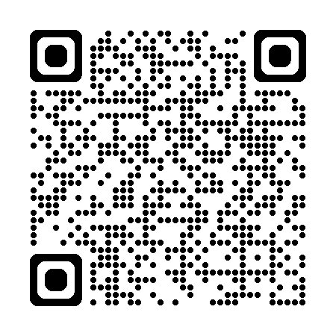
School-Life Balance Tips
Remember: You are more than just a student
Dedicate time and energy to your needs outside of academics
Maintain a schedule that works for you... and adjust as needed
Take breaks
Identify effective ways to take a break
Practice self-care
Build and engage your support system
Ask for help. No one succeeds alone
99 Self-Care Ideas

Slide 10
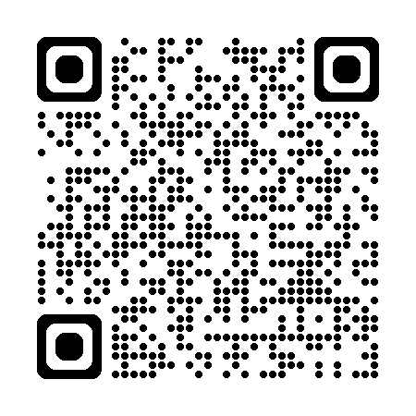
7 Types of Rest
Physical rest
Mental rest
Sensory rest
Creative rest
Emotional rest
Social rest
Spiritual rest
Article and TED Talk

Slide 11
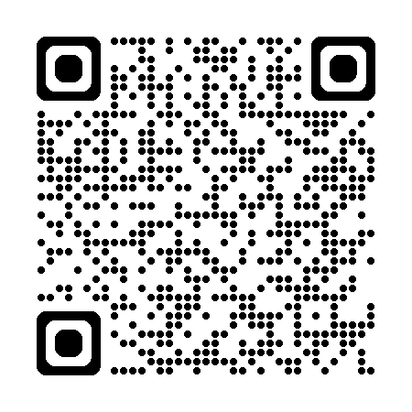
Academic Tips for School-Life Balance
Keep your home space and academic space separate (when possible)
Dedicate your bed/bedroom to sleep and relaxation
Put school/work items away and out of sight when not using them
Find a study space and environment that works for you
UW Study Spaces

Slide 12
Building Community & Minimizing Comparison to Others

Slide 13
Building New Connections
Notice the people around you in and outside of class
Be curious!
Have conversation starters to get the ball rolling
Build your tolerance for some social awkwardness and discomfort – it will pay off!
Explore and share your interests
Set and maintain social boundaries
Conversation Starters

Slide 14
Developing and Cultivating Friendships
Take initiative – Be okay reaching out first
Make time for the people who you want to stay connected to
Show interest by asking questions and remember things about people
Be consistent and dependable
Practice openness and authenticity – Be yourself!
Be willing to get a little vulnerable
Communicate your needs and practice healthy boundaries

Slide 15
Tips to Connecting with Others
Attend UW events
Get involved on campus – clubs, groups, volunteering, fitness classes, intramural sports, leagues and tournaments at the HUB, residence halls activities
Visit campus social spaces – the HUB, Q Center, ECC, CIRCLE, IMA
Can't find it? Make it happen! - Create an RSO or talk to staff/faculty who can help
Read bulletin boards and posters on campus
Read UW event newsletters and emails

Slide 16
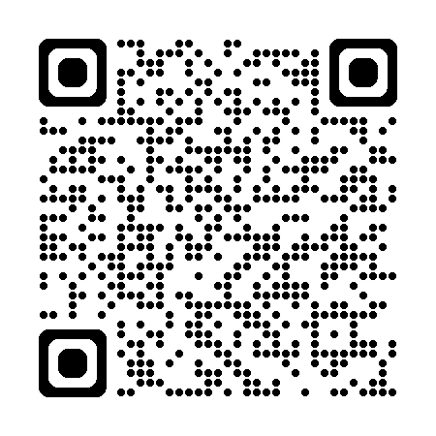
Navigating a Competitive Environment
Notice others without putting yourself down
Keep self-critical self-talk in check
Engage in positive self-talk – Be your own cheerleader
Manage your workload, time, and energy wisely
Ask for help
Utilize UW resources
Take care of yourself – body, mind, heart, and spirit
UW Student Services

Slide 17
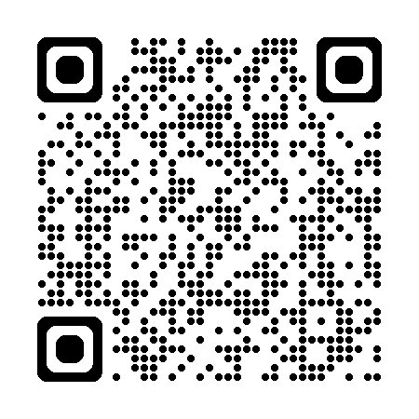
Know Yourself and Your Worth
You are more than your grades and academic performance
Learn what makes you smile, excited, inspired
Identify your strengths and positive qualities
Identify your core values
Believe in your ability to achieve and navigate tough situations
Dedicate time and energy towards your personal growth
Know that you are worthy – worthy of joy, rest, good things, connection, and success
List of values

Slide 18
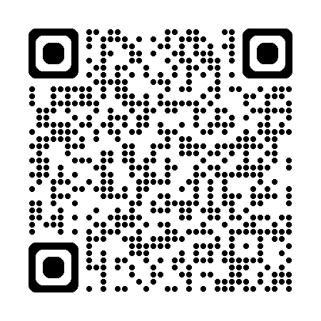
Connect with the UW Counseling Center
Phone: 206.543.1240
Location: Schmitz Hall 401
Hours: M, W, Th, F: 8:00 am – 5:00 pm, T: 9:30 am – 5:00 pm
Let's Talk drop-in spaces:
Ethnic Cultural Center: Tuesdays 2-4 PM
Q Center: Wednesdays 2-4 PM
CIRCLE: Fridays 2-4 PM

